Slide 1
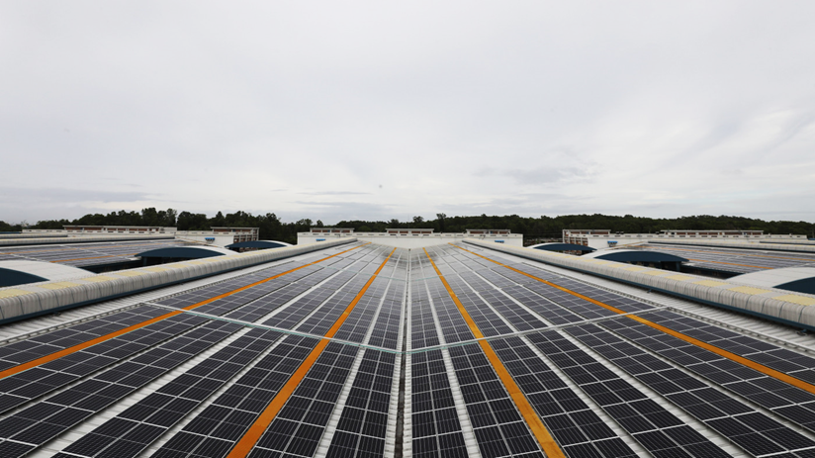

InSPIRE Technical Assistance
Scope of Engagement for Interested Applicants
Technical consultant and consultancy firm briefing
DDRA
Technical TA
Validation
Purpose of the engagement
Support selection and implementation of Challenge Fund projects through technical expertise, due diligence, risk assessment, project refinement, monitoring and performance validation.
Funded by the Embassy of Sweden | Implemented by Swisscontact

Slide 2
Why This Assignment Matters
Consultants help move applicants from ideas to investment-ready, implementable projects.
1. Selection stage
2. Readiness stage
3. Implementation stage
Review EOIs and full proposals, assess technical feasibility, and identify gaps in project design, budget and readiness.
Provide technical guidance to shortlisted applicants to refine interventions and strengthen implementation plans.
Support awarded partners with monitoring, verification, performance tracking and corrective actions.
Core objective
Ensure proposed Energy Efficiency (EE)/ Renewable Energy (RE) interventions are technically feasible, financially viable, scalable, aligned with InSPIRE requirements, and capable of delivering verified energy savings and GHG reductions.
InSPIRE Challenge Fund | Technical Consultant Engagement
2

Slide 3
Scope of Work: What Consultants Will Do
Technical review & investment readiness
Pre-award technical assistance
• Review EOIs, proposals and supporting documents
• Assess feasibility, scalability and expected performance
• Review baselines, savings, generation, GHG reduction and financial return
• Identify technical gaps and support refinement
• Support applicants in developing full proposals
• Advise on technology options and specifications
• Review budgets, workplans, procurement strategies and milestones
• Strengthen investment readiness before selection
Organisational & operational assessment
Site verification & validation
• Assess governance, staffing, decision-making and management systems
• Review O&M capacity and sustainability beyond project completion
• Identify strengths, gaps and capacity development needs
• Conduct site visits where required
• Verify equipment, infrastructure and operating conditions
• Confirm site suitability, assumptions, permits and implementability
InSPIRE Challenge Fund | Technical Consultant Engagement
3

Slide 4
From Due Diligence to Post-Award Support
The consultant role continues from assessment to implementation support, as required by the Fund Management Team.
1
2
3
4
5
Document review
DDRA & risk scan
Readiness advice
Implementation support
Validation & reporting
EOIs, full proposals, technical designs and supporting evidence
Technical, financial, operational, E&S and regulatory risks
Budgets, milestones, implementation plans and procurement strategy
Procurement guidance, commissioning, monitoring and troubleshooting
Risk matrix, readiness assessment, recommendations and IC inputs
Important expectations
Maintain independence, confidentiality and professional integrity. Disclose any conflict of interest before undertaking any assessment.
Output quality matters: findings should be evidence-based, concise, actionable and useful for decision-making.
DDRA- Due diligence & risk assessment
InSPIRE Challenge Fund | Technical Consultant Engagement
4

Slide 5
Who Should Apply?
Individual consultants
Consultancy firms
Specific strengths
Bachelor’s or higher degree in engineering, environmental science, renewable energy or related fields
At least 3 years of relevant professional experience
Experience with challenge funds or due diligence is an advantage
At least 3 years of similar service experience in RE, EE or related fields
Multidisciplinary team with relevant qualifications and experience
Donor-funded project experience will add value
Technical, financial and ESG due diligence in industrial or infrastructure projects
Strong understanding of RMG operations and sustainability standards
Ability to conduct inspections and write clear, actionable reports
High ethical standards and independence
InSPIRE Challenge Fund | Technical Consultant Engagement
5

Slide 6
Engagement, Evaluation and Submission
Engagement model
Evaluation weighting
Understanding of assignment
10%
Part-time and deliverable-based framework contract
Work Orders issued for each assignment
On-site and off-site work across Bangladesh as required
Expected period: contract award to September 2028
Technical expertise
20%
Prior experience in green technology/ financial sector/ RMG industry
30%
Documents to submit
Financial Proposal
30%
Brief understanding of the ToR
CVs of experts / consultants
Organisational profile, if firm
Relevant experience and evidence of similar assignments
Legal documents and all-inclusive daily rate
10%
Presentation
Submission
Submit to bgd.inspire@swisscontact.org by September 15, 2026. Subject line: “Application for Consultant to Provide Technical Assistance for InSPIRE Project”. Queries may be sent by September 12, 2026.
Shortlisted applicants will be asked to present up to 6 slides during the evaluation session.
InSPIRE Challenge Fund | Technical Consultant Engagement
6

